Slide 1

FED
WE
E
K
Building Carousels
Front End Development
Diploma in CSF
Year 1 (2021/22), Semester 2
7

Slide 2
Remote Learning Instructions
Step 1
Read the given slides
Details in slide 1-7
Step 2
Perform highlighted activities in Activities slide
Details in slide 8
Step 3
Complete and Submit Tasks given
Details in slide 9

Slide 3
Topics
1. Building Carousels using the Bootstrap framework
What is Carousel
Building your Carousels using the Bootstrap framework

Slide 4
Bootstrap
Bootstrap is a free front-end framework for faster and easier web development
Bootstrap includes HTML and CSS based design templates for typography, forms, buttons, tables, navigation, modals, image carousels and many other, as well as optional JavaScript plugins
Bootstrap also gives you the ability to easily create responsive designs
https://www.w3schools.com/bootstrap4/bootstrap_get_started.asp

Slide 5
Carousels
Carousels are one of the popular Bootstrap component.
It allows you to create a slideshow that auto-advances and gives you some controls to let you advance through the images.

Slide 6
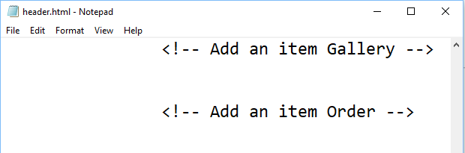
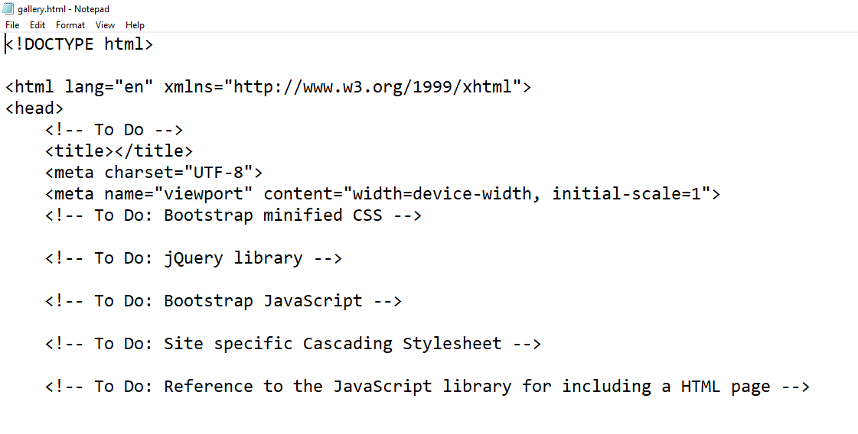
Carousel (Reference to Worksheet)
Partial coded header.html provided
Fill in correct code for Gallery and Order
Gallery stylesheet given
Partial coded gallery.html provided
Fill in correct code for gallery.html

Slide 7
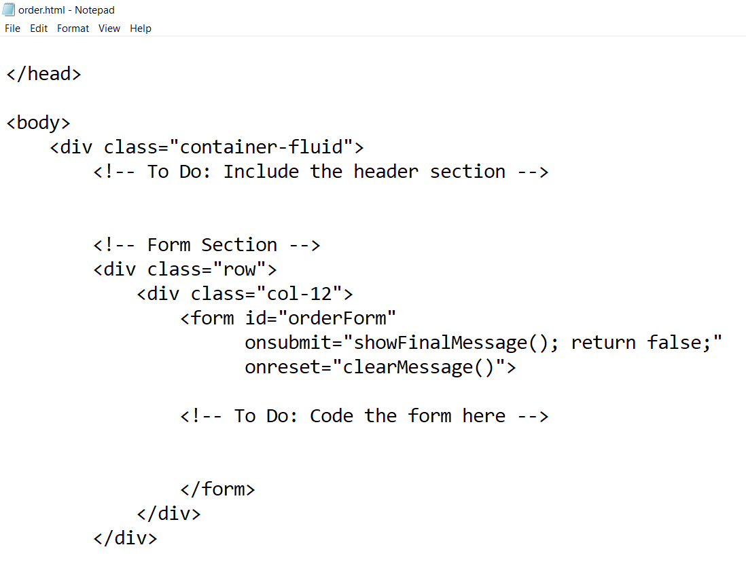
Order (Reference to Worksheet)
Partial coded order.html provided
Fill in correct code for order.html
Order stylesheet NOT provided. Students to code for the order stylesheet themselves.

Slide 8
Activities
Watch the video clip - Bootstrap 4 Carousel
https://www.youtube.com/watch?v=AvMl3StAju4
Follow the article to create Bootstrap carousel https://getbootstrap.com/docs/4.0/components/carousel/

Slide 9
Tasks
Complete Week 7 Practical.
Download Week 7 Practical in MEL – “FED 2021-10 Week 7 Worksheet.pdf”
Deadline end of Week 7
Submit the completed practical files in MEL.
Zipped the source files
Name the zipped file in following format:-
FED-Week07-SXXXXXXXX (where SXXXXXXXX is your student id)
Submit the zipped file in the weekly folder’s submission link in MEL
Also, submit the zipped file into FED network folder (https:///ictspace.ict.np.edu.sg/FED) under your studentID. This is for backup purpose only. Main submission is still in MEL.
If you have any questions please communicate with your tutor via Microsoft Teams.

Slide 10
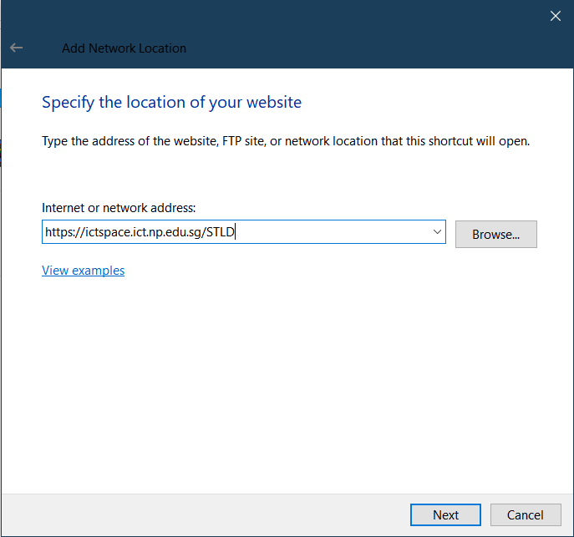
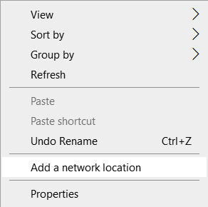
Appendix
Mapped to FED network folder
For Win Users
Right click on a blank space in your Windows Explorer
Select ‘Add a network location’
3. Enter https://ictspace.ict.np.edu.sg/(your assigned module)
4. Press ‘Next’

Slide 11
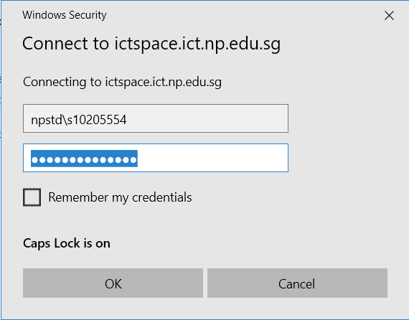
Appendix (Cont)
10123453
4. Login using npstd\s(your student ID number without the last alphabet)
5. Enter your NP student account password

Slide 12
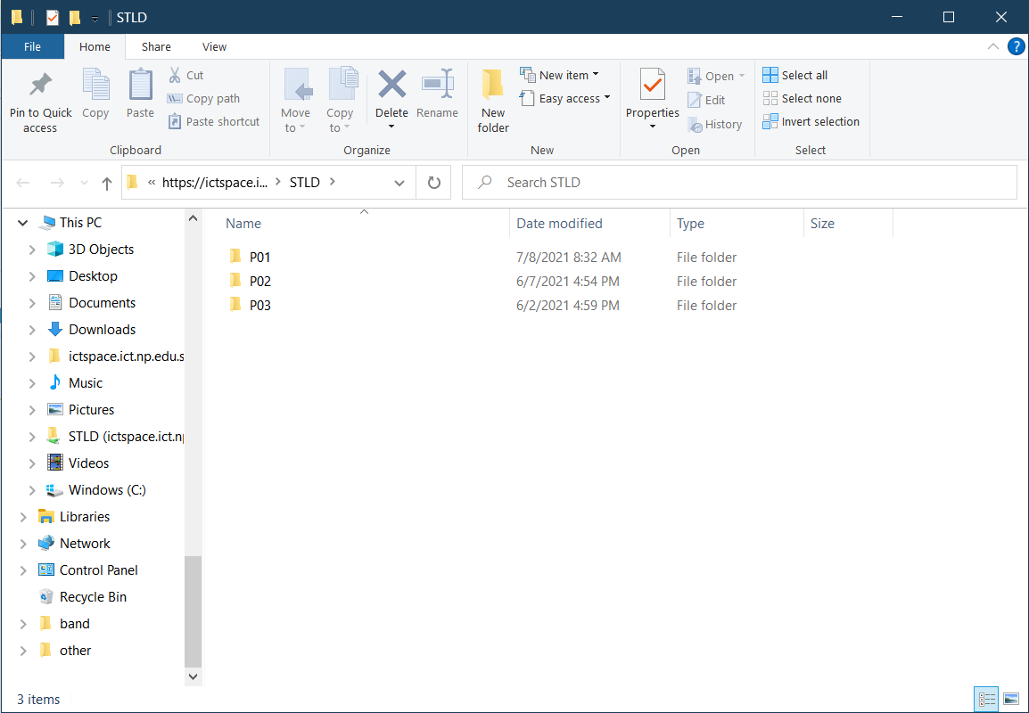
Appendix (Cont)
You should be able to see your class folder as shown in the example below.

